Slide 1
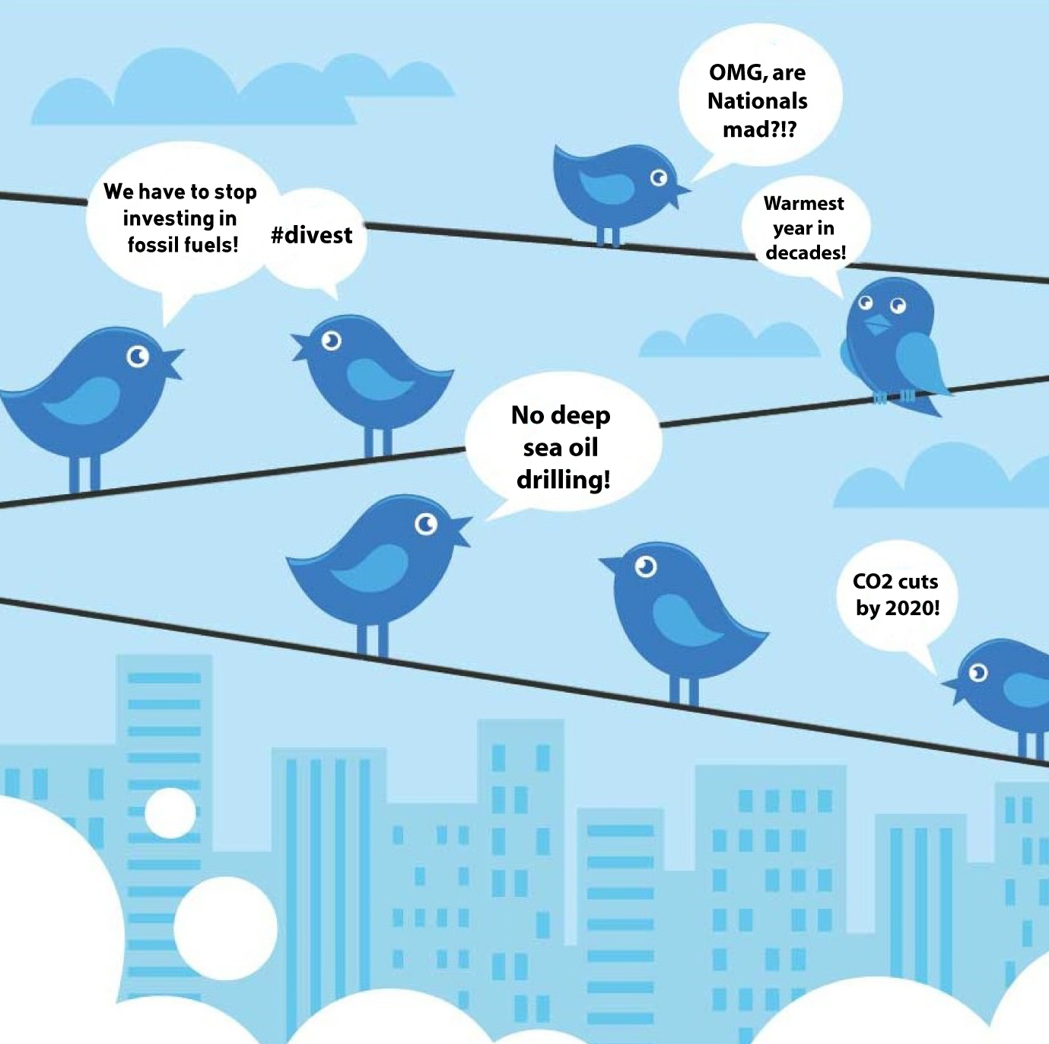
Climate Change Discourse on Twitter
Isabel Arvelo

Slide 2

Motivation
What are the main topics, themes, and narratives that dominate climate change discussions on Twitter? What does the discourse tend to focus on?
What individuals, organizations, locations, and other entities are most influential in shaping the climate change narrative on Twitter?

Slide 3

Dataset Overview: Climate Change Tweets on Twitter
Source: Tweets scraped by Kaggle user Diego Farchione
Duration: Captured from January 2022 to July 2022.
Content: Highlights top tweets with the keyword 'Climate Change’ between January 2022 to July 2022.
Key Features (for each tweet):
User & Tweet Details:
User Screen Name, Username, Text, Date
Engagement Metrics :
Comments, Likes, and Retweets
Additional Context:
Emojis, Image Link

Slide 4
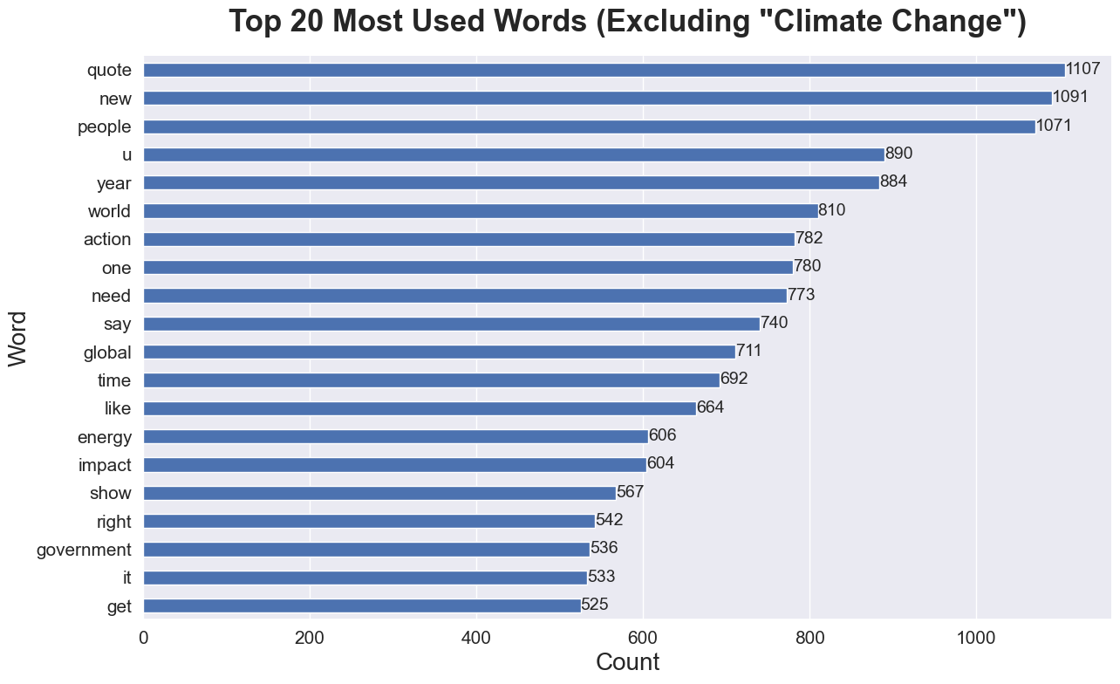
Analysis: Word Frequency
Referencing & Responsibility: High mentions of "quote," "people," and "world" show a trend of referencing others and emphasizing global responsibility.
Urgency & Action: Terms like "action," "need," and "crisis" highlight the immediacy and urgency in the climate change discourse.
Topics & Solutions: Words such as "energy," "impact," and "global" point to discussions on renewable solutions and global effects.
Notes:
The term "quote" with 1107 mentions suggests a lot of the climate change conversation on Twitter involves referencing or discussing opinions and statements made by others. This could be experts, politicians, activists, or celebrities.
"People" and "world" with 1071 and 810 mentions respectively emphasize the collective and global nature of the issue. It indicates that the discussions are not about isolated incidents or regional concerns but have a global perspective.
Words indicating urgency like "action," "need," and "crisis" with 782, 773, and 500 mentions respectively, indicate that many tweets emphasize the pressing and immediate nature of the problem.
Specific topics like "energy" (606 mentions) suggest discussions might be centered around renewable energy sources, ways to reduce carbon footprint, and sustainable living.
"Impact" with 604 mentions can be related to discussions about the effects of climate change on the environment, wildlife, and human populations.
The term "global" with 711 mentions further cements the idea that the discussions are about the worldwide effects of climate change and not restricted to specific regions.

Slide 5
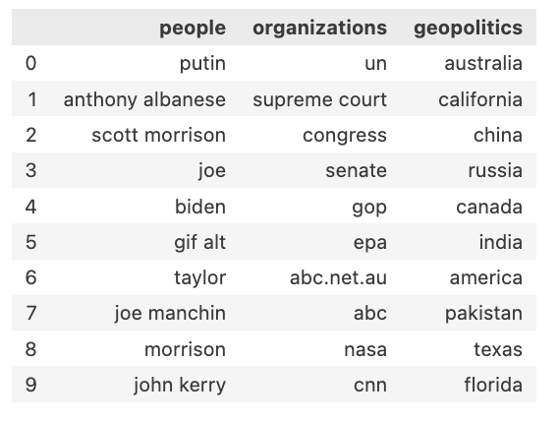
Analysis: Named Entity Recognition
Top Mentioned Entities in Tweets
Prominent Figures & Politics:
High mentions of political figures like "Putin," "Scott Morrison," and "Joe Biden" indicate a political angle to the climate change discourse.
Global Institutions & Media:
Organizations like "UN," "Supreme Court," and media outlets "abc.net.au" and "CNN" suggest authoritative sources and media's role in the conversation.
Global Spread:
Geopolitical mentions span continents, from "Australia" to "China" and "California" to "Russia," showcasing the global nature of the climate issue.
Table 1: A summary of the most frequently mentioned people, organizations, and geopolitical entities in the analyzed tweets.
Notes:
People:
The mention of political figures like "Putin," "Anthony Albanese," "Scott Morrison," and "Joe Biden" indicates that the climate change conversation is intertwined with political decisions and leadership stances. These are global leaders whose actions and decisions have a significant impact on climate policies.
"Joe Manchin" and "John Kerry" further emphasize the U.S. political angle, with Manchin being a pivotal senator on climate decisions and Kerry as the U.S. Special Presidential Envoy for Climate.
Organizations:
The "UN" (United Nations) being the top organization suggests discussions around global policies, agreements, or conventions related to climate change.
Judicial entities like the "Supreme Court" and legislative bodies like "Congress" and "Senate" hint at legal and legislative discussions related to climate change.
The presence of media outlets and organizations such as "abc.net.au," "ABC," and "CNN" showcases the media's role in reporting, influencing, or driving the climate change narrative.
The inclusion of "NASA" could be related to research, satellite data, or space-based observations of Earth's climate.
Geopolitics:
The wide range of places from "Australia" to "Russia" and "California" to "India" highlights the global concern of climate change. It's not confined to one region but is a shared responsibility and concern across continents.
Specific mentions like "California" might refer to wildfires or state-specific climate initiatives. "China" and "India" are two of the world's most populous countries and major carbon emitters, so their policies and actions are crucial for global climate goals.
This structured analysis provides an understanding of the prominent figures, organizations, and places shaping the climate change conversation. The mentions provide a blend of political, scientific, media, and geographical perspectives, highlighting the multifaceted nature of the climate change discourse.

Slide 6
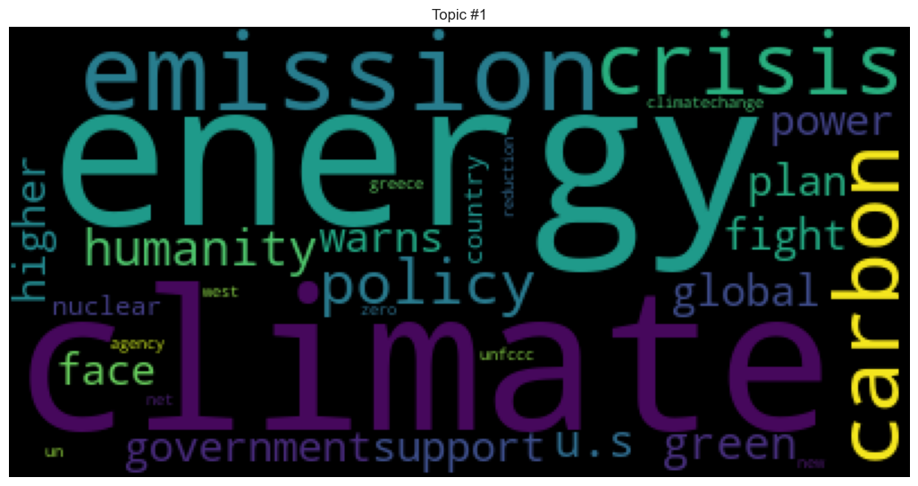
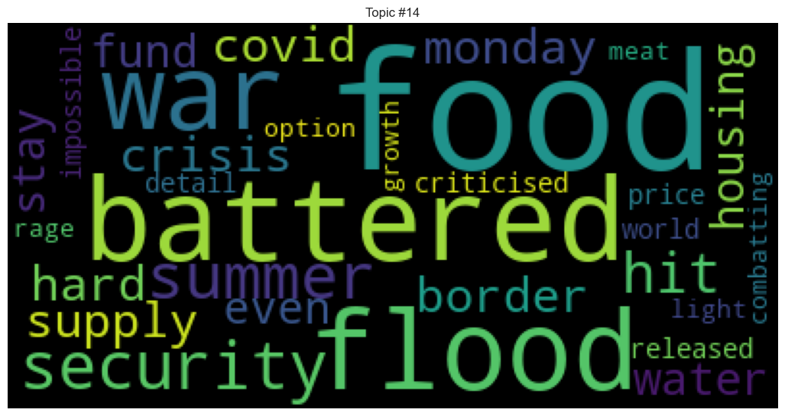
Analysis: Topic Modeling
Topic modeling is a technique that automatically identifies and groups main themes or topics within large volumes of text
Topic 1: Climate Policy and Implications
A focus on energy, climate change, emissions, and carbon footprint, hinting at a discourse around climate crisis and the policies needed to address it.
Terms like "U.S" and "green" might be indicating regional or global environmental policies.
Climate Policy and Implications
Topic 2: Food Security Amid Disasters
Discussions on food security in times of floods, wars, and other disasters, highlighting the challenges faced during summer or other critical times.
Food Security Amid Disasters
Notes:
Energy Sources and Their Impact:
Discussing the environmental impact of different energy sources.
Legal implications with energy companies.
Highlight: Advocacy against harmful energy practices and fossil fuels.
Technical & Policy Aspects:
Delving into carbon emissions and energy sources.
Discussing potential strategies and policies.
Highlight: Intersection of climate change with food and agriculture.

Slide 7



Takeaways
Word Frequency Analysis
Sense of urgency & need for immediate action
Solution-oriented discourse
Emotionally-charged debates
Named Entity Recognition
Politicized issue, especially in US
Media outlets shape narrative
Global issue with local impacts
Topic Modeling
Holistic Climate Discourse
Cross-Sectoral Resilience
Interplay of Policy and Community Action
Notes:
Word Frequency Analysis
The discourse reflects a sense of urgency and need for immediate action, as indicated by words like "now", "action", "fight". This suggests many users see climate change as a pressing issue.
Solution-oriented words like "energy", "emissions", "sustainable" indicate people are discussing potential responses to climate change.
Emotionally-charged words like "denial", "hoax", "future" highlight the passionate nature of debates on this topic.
Named Entity Recognition
The prominence of US political entities reflects how climate change has become highly politicized and partisan in the US. Policy decisions play an outsized role.
Frequent mentions of media outlets demonstrate their influence in shaping the narrative and public opinion around climate change.
Focus on local regions and impacts reveals climate change is seen as a global but locally relevant issue.
Topic Modeling
Holistic Climate Discourse: Engaging in a comprehensive dialogue encompassing the climate crisis, energy policies, and environmental impacts while intertwining legal, ethical, and political dimensions, reflecting a growing awareness and urgency toward global and regional environmental issues.
Cross-Sectoral Resilience: Embracing an interdisciplinary lens to explore solutions, from leveraging renewable energy, addressing food security amid disasters, to dissecting the socio-economic implications, fostering a multifaceted approach to resilience and sustainability in face of environmental and societal challenges.
Overall the analysis reveals climate change conversations on Twitter are multidimensional, tapping into science, policy, politics, culture. But urgency and alarm dominate overhope. More solutions-focused messaging may be impactful.

